Slide 1
Monitoring Azure
mit Application Insights und Ruxit
Dynatrace Austria GmbH
Gergely Kalapos
Martin Gutenbrunner

Slide 2
Bio
Gergely Kalapos (short: Gergö)
Web: kalapos.azurewebsites.net Twitter: @gregKalapos
Software Engineer at Dynatrace (working with .NET)
Studied Computer Engineering in Budapest and Software Engineering in Linz
Writes code mainly in C# and C++

Slide 3
Martin Gutenbrunner
Started with Commodore 8-bit (VC-20 and C-64)
Built IPX/SPX Networks between MS-DOS 6.22 and WfW 3.11
And Null-Modem connections for playing Doom and WarCraft I
Did DevOps before it was a thing (mainly Java and Web)
Now at Dynatrace Innovation Lab
Tech Lead for Azure
Married, two children
@MartinGoodwell

Slide 4


Slide 5
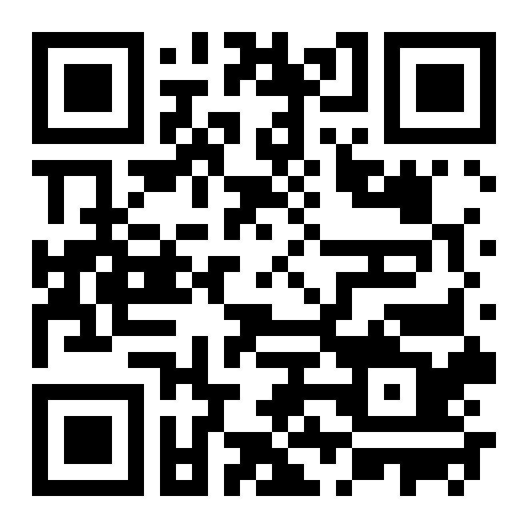
http://smileybrain.azurewebsites.net

Slide 6
Application Insights

Slide 7
Content
Very short introduction about APM/Application Insights/Ruxit with slides
DEMO

Slide 8
Application Insights
Works both with web and standalone apps. -> Not Azure only
Not only .NET! (e.g. works with Java, iOS, Android, etc.)

Slide 9
Application Insights - Features
1) Analyze usage pattern
Page view count, new/returning users, platforms, geolocation, etc.
Trace usage paths to evaluate the success of a feature
2) Detect performance Issues
Alert on performance changes or crashes
Exception reports
Response time/CPU usage
Dependency tracking

Slide 10
Application Insights - Architecture
Azure
The notion of an application
An Application
-accepts requests,
-spits out exceptions and traces and logs
-it can be instrumented on usage events (for control flow events) and metrics
-It relies on dependences
The APIs reflect these principles
Web Based UI within the (new) Azure portal
JSON Endpoint
SDK
AppInsights Core

Slide 11
Application Insights - Features
SDK provides many information out of the box (without writing code)
Additionally you can code your own telemetry

Slide 12

Application Insights
DEMO
ASP.Net MVC
REST Service
UWP App

Slide 13
Resources
https://azure.microsoft.com/en-us/documentation/services/application-insights/
https://channel9.msdn.com/Events/Build/2016/B838
https://channel9.msdn.com/Events/Build/2015/3-719
https://channel9.msdn.com/Shows/Azure-Friday/Instrumenting-your-Web-API-using-Application-Insights-with-Victor-Mushkatin
https://channel9.msdn.com/Events/Build/2015/3-624

Slide 14
Dynatrace Ruxit
http://smileybrain.azurewebsites.net

Slide 15
What is Ruxit?
Monitoring
IaaS
PaaS
Real-User-Monitoring

Slide 16
Martins Part
Install WebSite Extension to Gergely‘s WebSite
Show PaaS functionality
IaaS (Azure Compute)
Show spring-music app
Including source-code as „proof“ for no-agent-injection
Install Ruxit Host Agent
Restart spring-music and databases
Click through spring-music app
Show source-code
demo.live.ruxit.com
Present smileybrain RUM data

Slide 17
BrainSmiley App Summary
Fun: 46
Interesting: 57

Slide 18
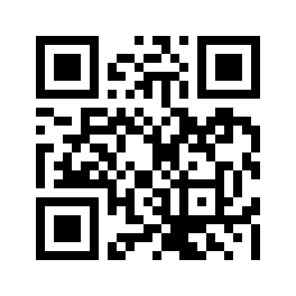
References
http://bit.ly/2016-hours-free
www.ruxit.com
@MartinGoodwell

